Slide 1
A Semiautomatic Cell Boundary and Adherens Junction Layers Detection Approach Using Level Set Method
Jingzhi Wang
MAE department
Advisor: Dr. E.T. Esfahani
Committee members:
Dr. Rahul Rai and Dr. Souma Chowdhury

Slide 2
Contents 1. Motivation 2. GAC level set 3. Images and assumptions 4. Procedure 5. Results 6. Conclusion and future work

Slide 3
1. Adherens Junctions(AJs)
Are an essential component of tissue cells, physically connects the neighboring cells.
How adhesive interactions between cells generate and maintain animal tissue structure remains one of the most challenging and long-standing questions in cell and developmental biology [1].
Live cell imaging has been widely used to study AJ dynamics. Although several software is available for image analysis, identification AJs remains challenging.
Experts in related fields usually draw AJs manually for better accuracy, which may take months.

Slide 4
2. Recent work
In recent years some great work has been finished to help locate the boundary and adherens junctions like tensor voting [2] and SeedWater Segmenter [3].
However
Time expansive.
Not good on ill-defined images with small number of cells.
Only label the junctions with curves.

Slide 5
Contents 1. Motivation 2. GAC level set 3. Images and assumptions 4. Procedure 5. Results 6. Conclusion and future work

Slide 6
1. Introduction to GAC level set
Kass et al finished 'snakes' in 1988 [4].
Boundary detection is achieved by minimizing a energy function.
Caselles et al proved that the snakes model is equivalent to finding a geodesic curve in a Riemannian space [5].
New approach for boundary detection via active contours, based on geodesic computation.

Slide 7
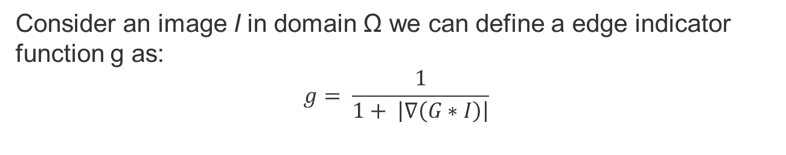
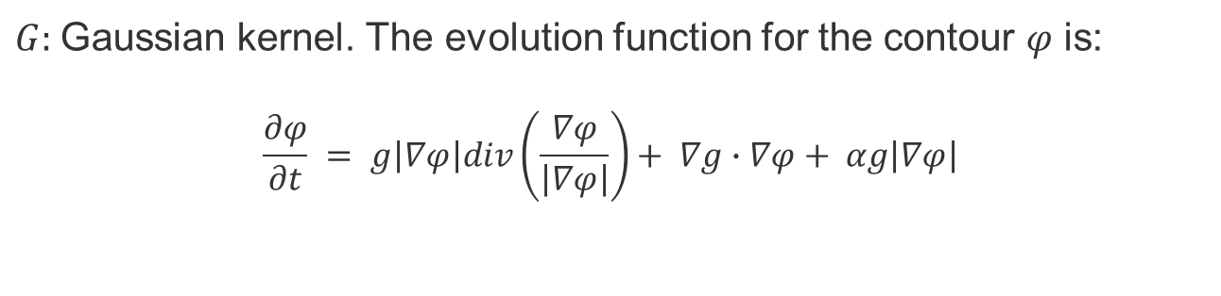
2. GAC evolution
Consider an image I in domain Ω we can define a edge indicator function g as:
$$g= \frac{1}{1+ \left|∇\left(G∗I\right)\right|}$$
$G:$Gaussian kernel. The evolution function for the contour $φ$ is:
$$\frac{∂φ}{∂t} = g\left|∇φ\right|div\left(\frac{∇φ}{\left|∇φ\right|}\right)+ ∇g∙∇φ+ αg\left|∇φ\right|$$

Slide 8
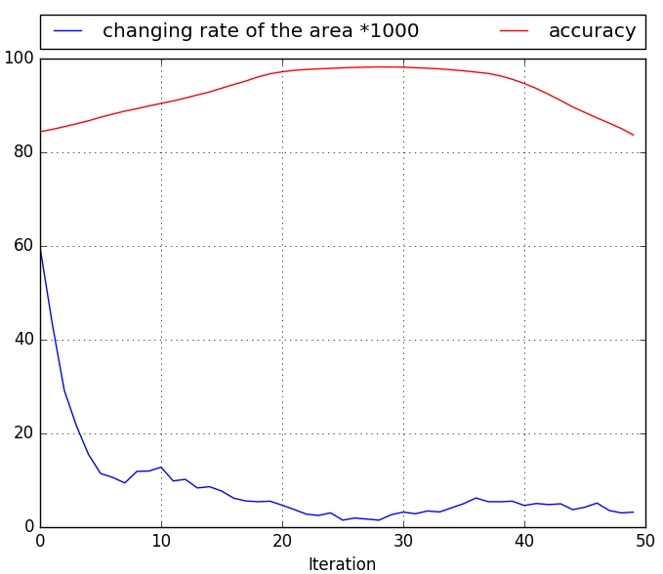
3. Data-driven stopping criterion
Changing rate of the contour area is chosen.
The highest accuracy doesn’t come from the iteration with minimum value of changing rate of the area.
Top 5 points with the smallest value of changing rate of the area,
The one with the largest number of iteration

Slide 9
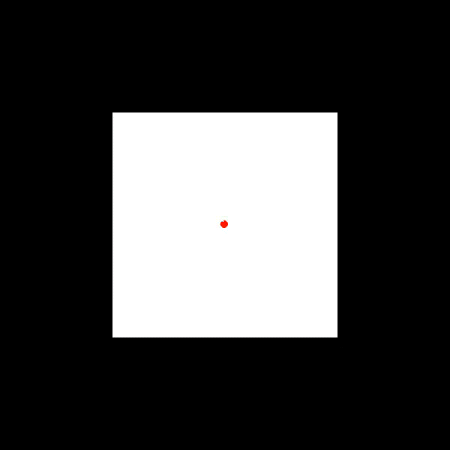
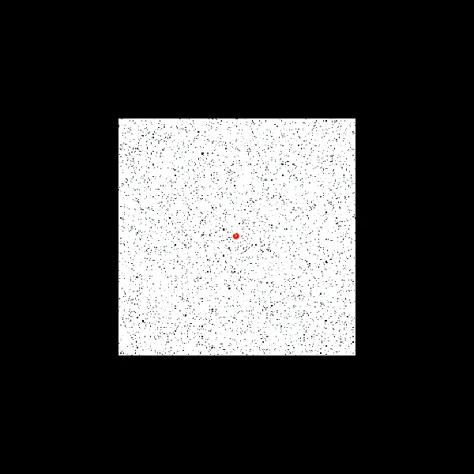
4. Challenge
level set method performs bad when dealing with images with random noises in the detection area.

Slide 10
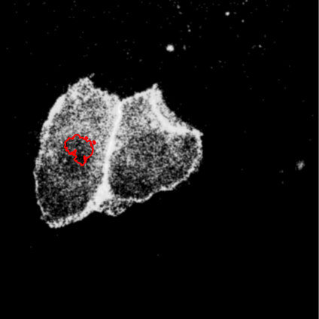
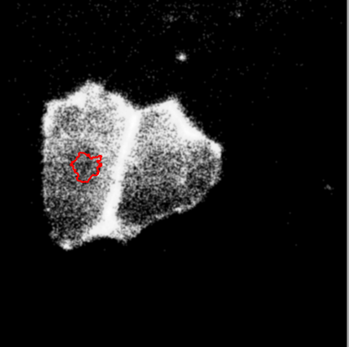
4. Challenge
You get this if you run level set inside the cell directly

Slide 11
Contents 1. Motivation 2. GAC level set 3. Images and assumptions 4. Procedure 5. Results 6. Conclusion and future work

Slide 12
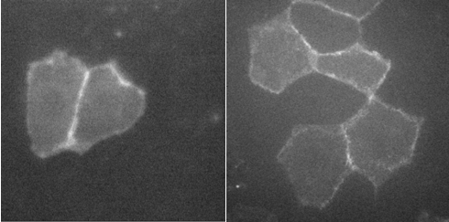
1. Images
We are using the red fluorescent protein images (RFP). For this research, one dataset with 19 images and the other one with 90 images of RFP tagged E-cadherin in MDCK cells are studied.
Images for this research are collected by Dr. Susan Zonglu Hua’s biomechanical lab in the department of MAE.

Slide 13
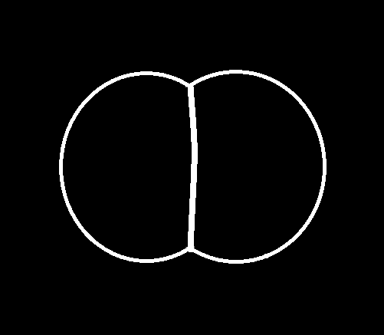
2. Assumptions towards cell images
The boundary of the cluster is a layer of pixels with higher intensities.
The junction is usually long and brighter (has higher pixel intensities) than pixels close to it.
The junction is straight enough to perform linear regression.
Illustration for ideal cell cluster

Slide 14
Contents 1. Motivation 2. GAC level set 3. Images and assumptions 4. Procedure 5. Results 6. Conclusion and future work

Slide 15
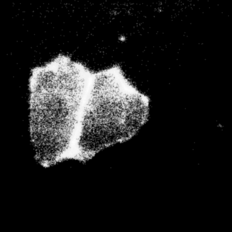
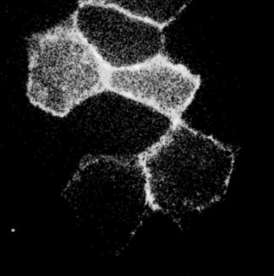
1. Image preprocessing
Perform cut-off or ratio threshold then use Gaussian kernel to smooth noises.

Slide 16
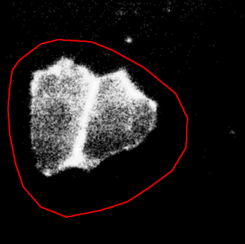
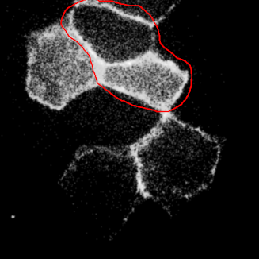
2. Draw initial box manually for level set
To set starting box for level set and avoid noises

Slide 17
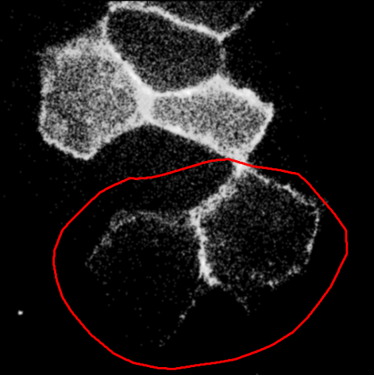
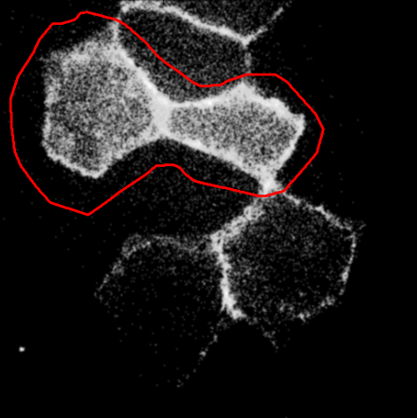
2. Draw initial box manually * Violation of the assumptions
The boundary of the cluster is not bright enough to be detected.
The junction between two cells is too short.

Slide 18
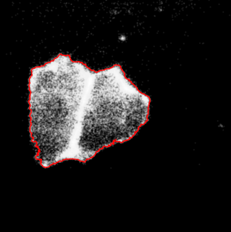
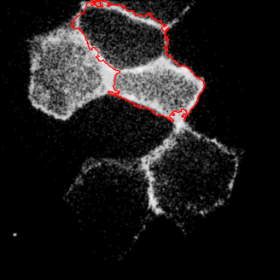
3. First level set

Slide 19
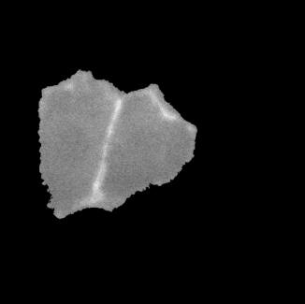
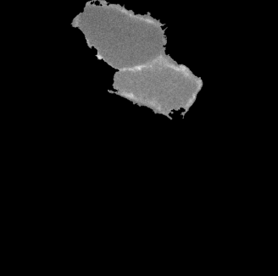
4. Divide the cluster into two cells
1) Clear everything else and rescale images to enhance contrast.

Slide 20

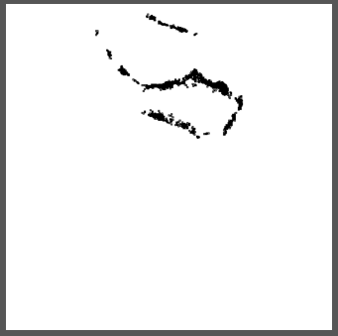
4. Divide the cluster into two cells
2) Sobel edge detection
Points here are called being in the Sobel Pool

Slide 21
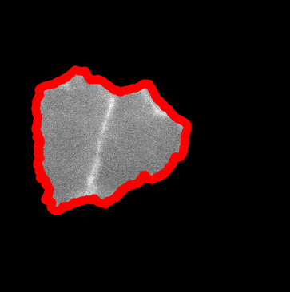
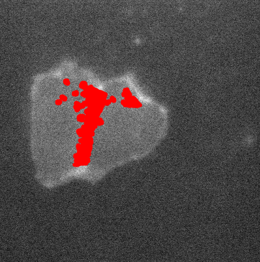
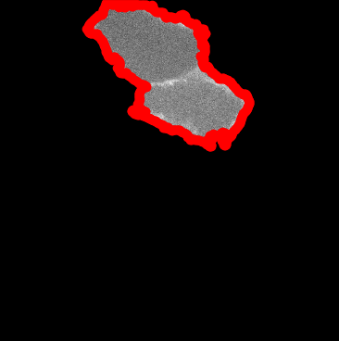
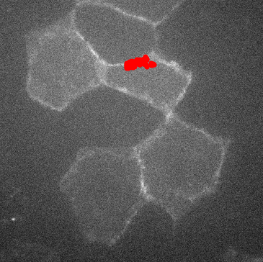
4. Divide the cluster into two cells
3) Collect points for linear regression
+
=
Zero-crossing points
Points in Sobel pool that are away from ZC

Slide 22
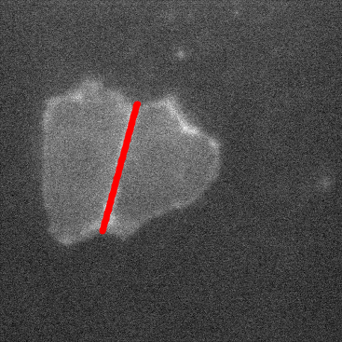
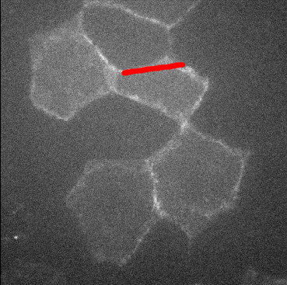
4. Divide the cluster into two cells
4) Linear regression

Slide 23
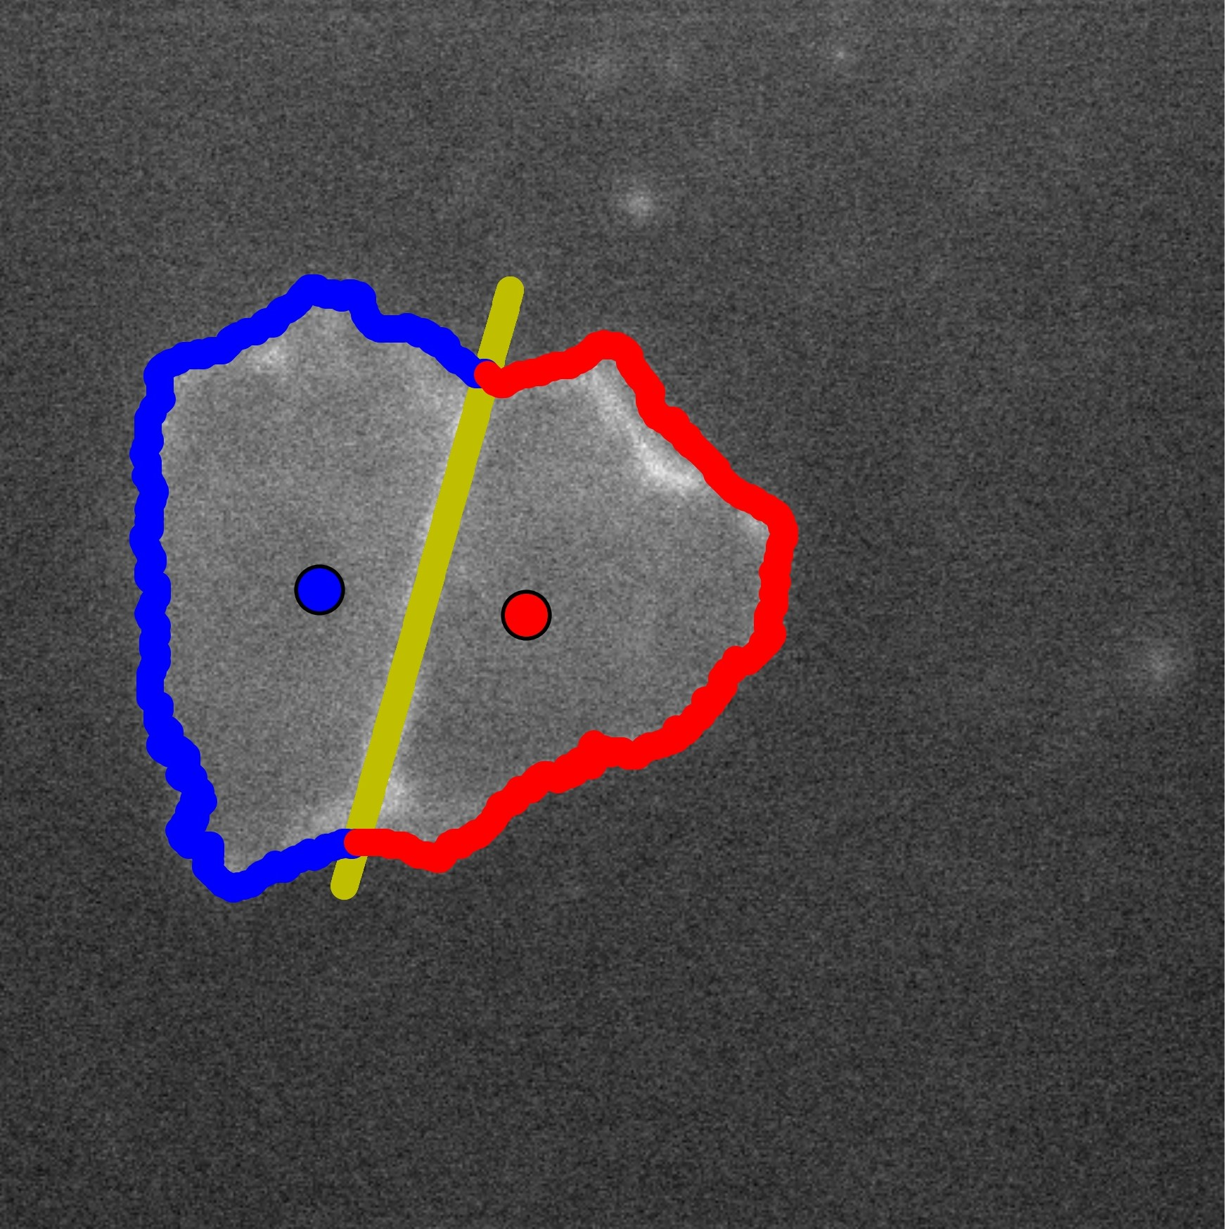
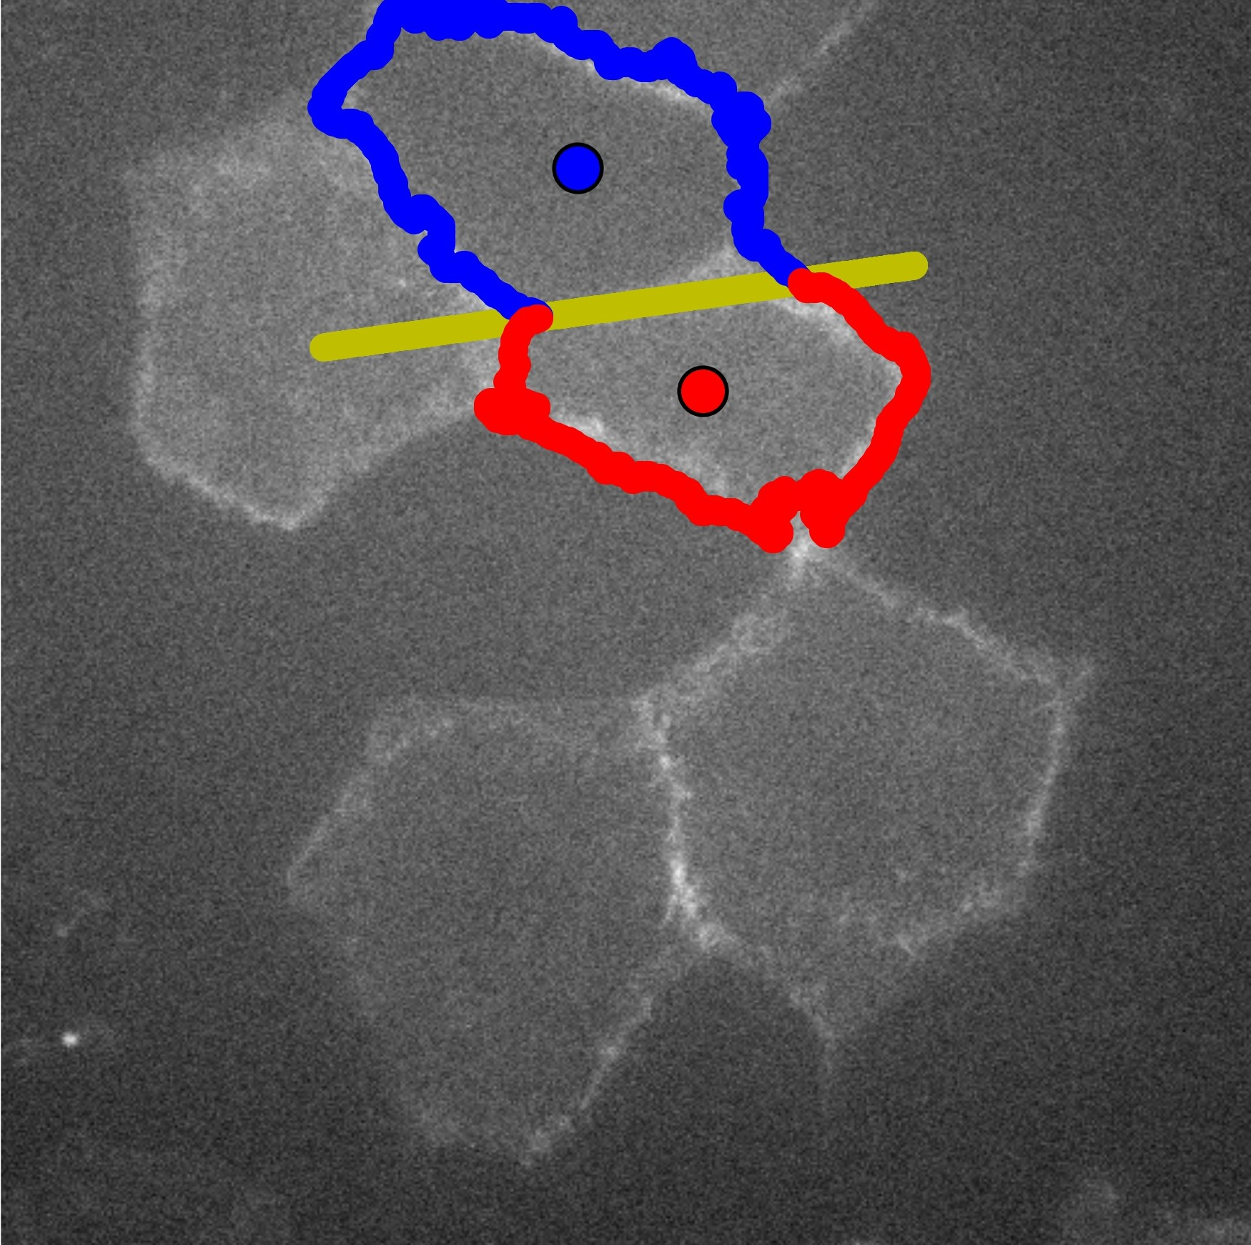
4. Divide the cluster into two cells
5) Divide the cluster with the line

Slide 24
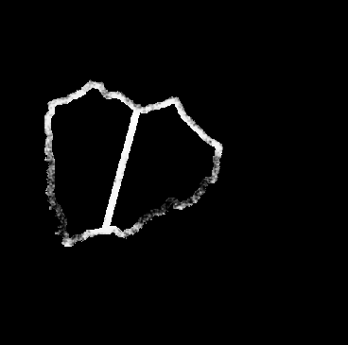
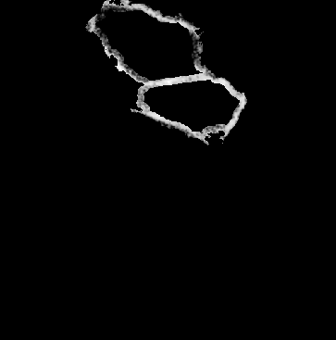
4. Divide the cluster into two cells
6) Clear everything else

Slide 25
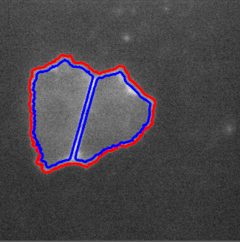
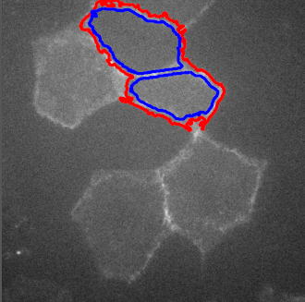
5. Second level set

Slide 26
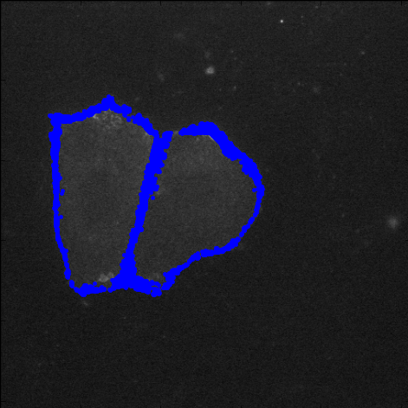
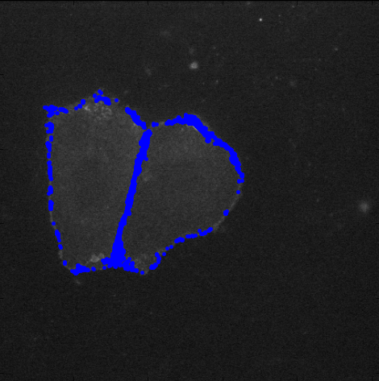
6. Modification
In some cases the junction layer is very thin hence the two level set contours overlap. So we add bright points close to the junction to modify it.
Cut-off threshold 200
Ratio threshold 99.9%

Slide 27
Contents 1. Motivation 2. GAC level set 3. Images and assumptions 4. Procedure 5. Results 6. Conclusion and future work

Slide 28
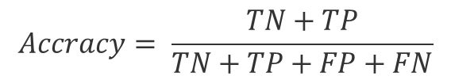
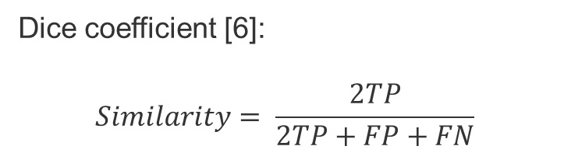
1. Performance measurement
Two ways to measure performance:
$$Accracy= \frac{TN+TP}{TN+TP+FP+FN}$$
TN: true negative
TP: true positive
FP: false positive
FN: false negative
Dice coefficient [6]:
$$Similarity= \frac{2TP}{2TP+FP+FN}$$

Slide 29
1. Performance measurement
Check 15 images from each dataset
Results:
Accuracy: 96.35% for dataset 1 and 97.53% for dataset 2
Std: 0.45 and 0.18
Similarity: 50.16% for dataset 1 and 62.42% for dataset 2
Std: 3.51 and 0.14
Similarity not good: thin junction layers make it very sensitive, hence still good.

Slide 30
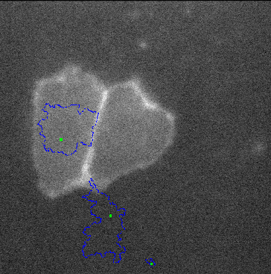
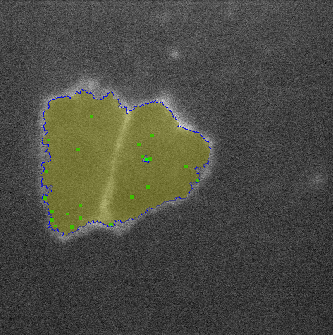
2. Compare with previous work
SeedWater Segmenter [2] is a cell image segmentation algorithm that can detect the junctions either automatically or semiautomatically.
Automatic(x)
Semiautomatic

Slide 31
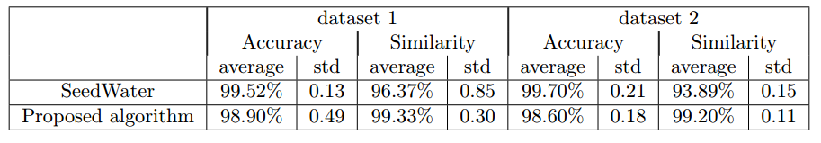
2. Compare with previous work
Since SeedWater Segmenter can only detect outer boundary, comparison between the two algorithm should be about the detecting accuracy of the outer boundary.

Slide 32
Contents 1. Motivation 2. GAC level set 3. Images and assumptions 4. Procedure 5. Results 6. Conclusion and future work

Slide 33
1. Conclusion
In terms of biological contribution, this research introduces a new approach that detect boundary layers and adherens junctions of cells.
In terms of computational contribution, we presents a modified data driven stopping criterion for the classic level set method.

Slide 34
2. Future work
Noise Removal
Situations with More than Two Cells
Application Interface

Slide 35
Reference
Harris TJ, Tepass U (2010) Adherens junctions: From molecules to morphogenesis. Nat Rev Mol Cell Biol 11:502–514
Leandro A. Loss, George Bebis, and Bahram Parvin. Iterative tensor voting for perceptual grouping of ill-defined curvilinear structures. IEEE Trans. Med. Imaging, 30(8):1503–1513,2011.
David N. Mashburn, Holley E. Lynch, Xiaoyan Ma, and M. Shane Hutson. Enabling user-guided segmentation and tracking of surface-labeled cells in time-lapse image sets of living tissues.Cytom. Part A, 81 A(5):409–418, 2012
Michael Kass, Andrew Witkin, and Demetri Terzopoulos. Snakes: Active contour models.Int.J. Comput. Vis., 1(4):321–331, jan 1988.
Vicent Caselles, Ron Kimmel, and Guillermo Sapiro. Geodesic Active Contours.Int. J. Comput.Vis., 22(1):61–79, 1997.
Lee R. Dice. Measures of the Amount of Ecologic Association Between Species.Ecology,26(3):297–302, jul 1945.

Slide 36
Thank you very much!

